Slide 1


Sleep Study Analysis
Exploring Patterns Through Data Visualization
SASHI RAJ AMATYA

Slide 2

Introduction
According to CDC, we need enough sleep to maintain optimal health and well-being.
Over half of Americans aren’t getting enough sleep – Healthline.

Slide 3
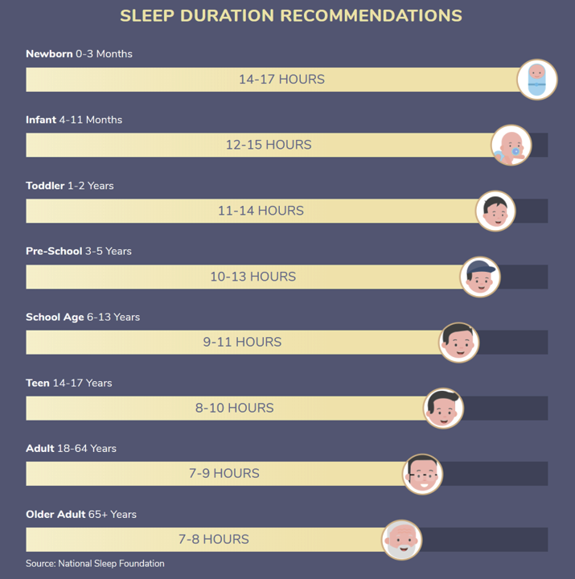
Recommendation

Slide 4

OBJECTIVE
To determine if more than 50% of Americans do not get enough sleep using hypothesis testing.

Slide 5
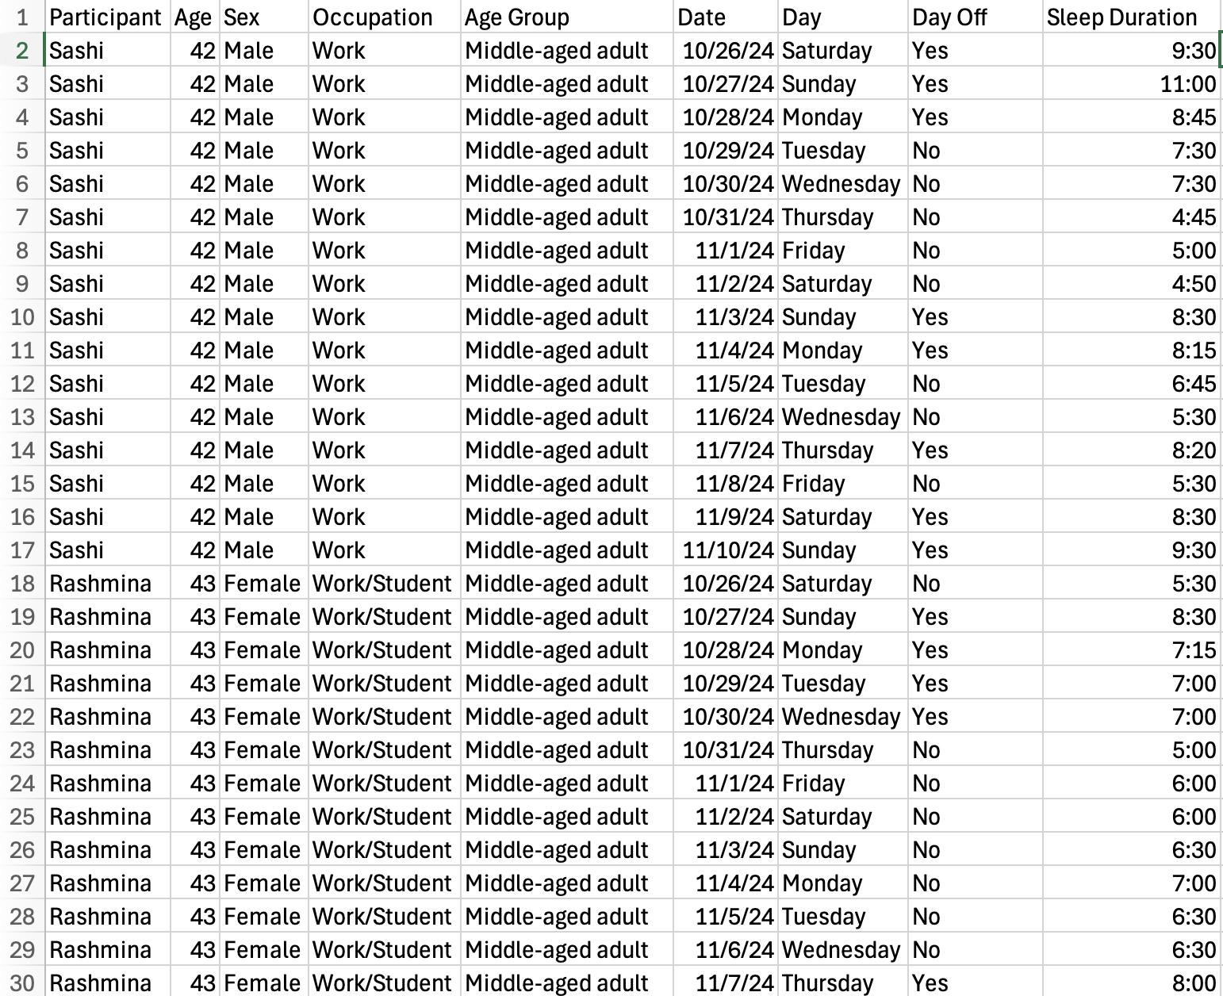
Data

Slide 6
Data collection
Ethically Sourced.
64 observations over the period of 16 days.
Age group: a child, a teen, and two adults.
Variables: age (IV), day off (IV), and sleep duration (DV).
Sample size: 4

Slide 7
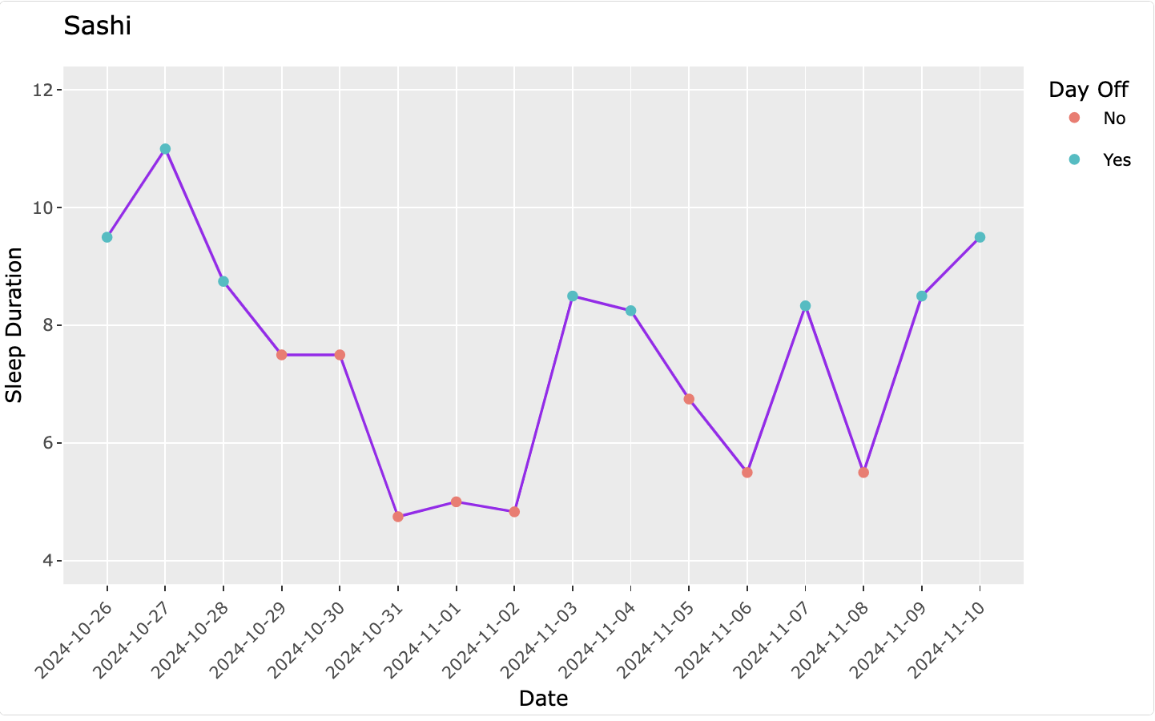
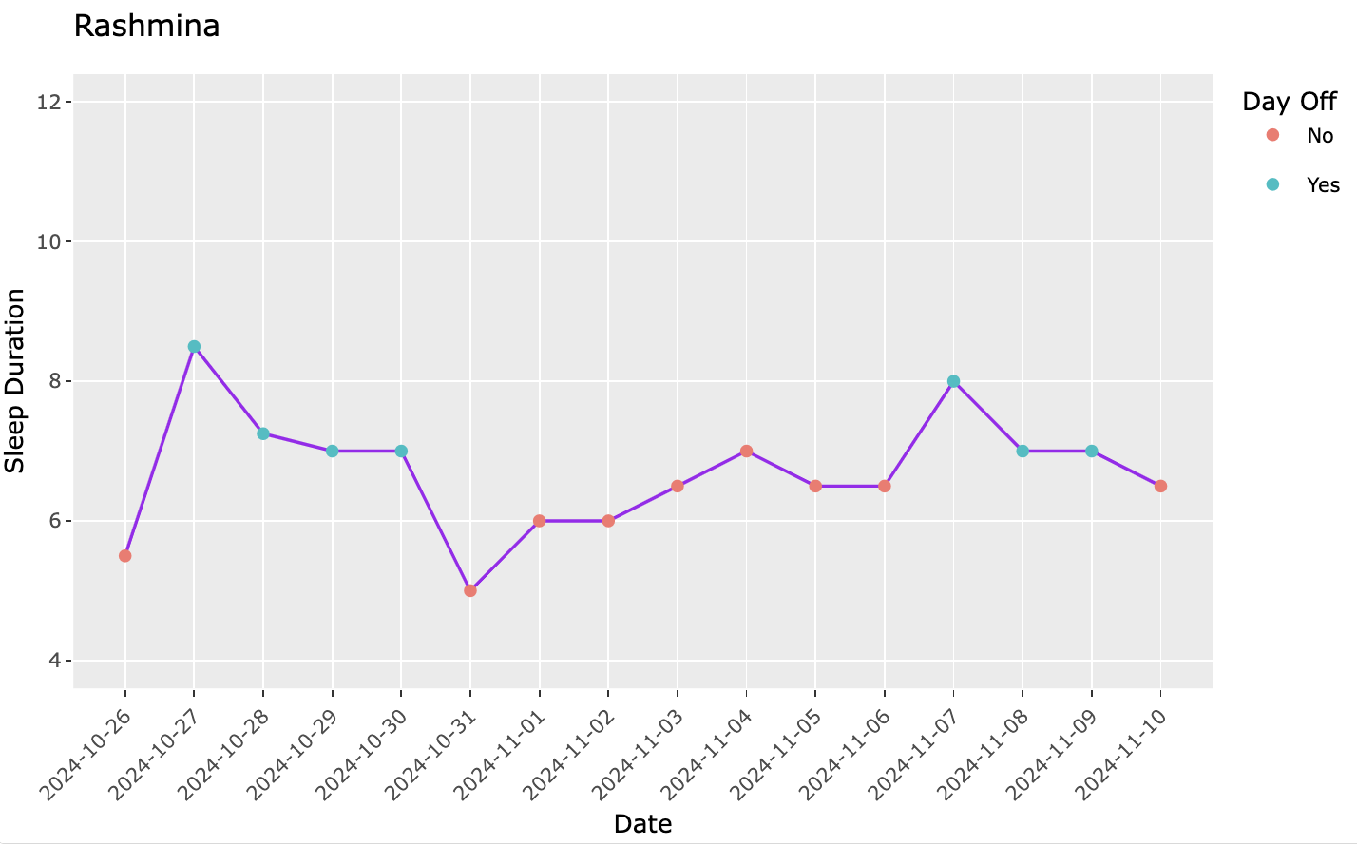
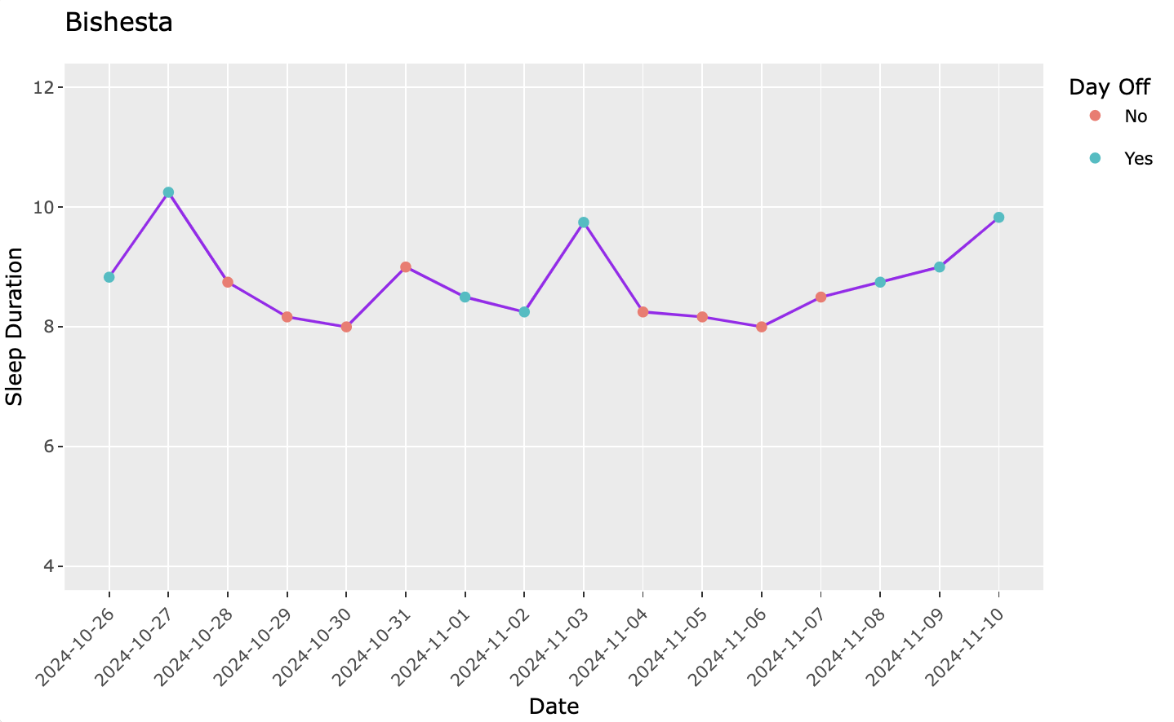
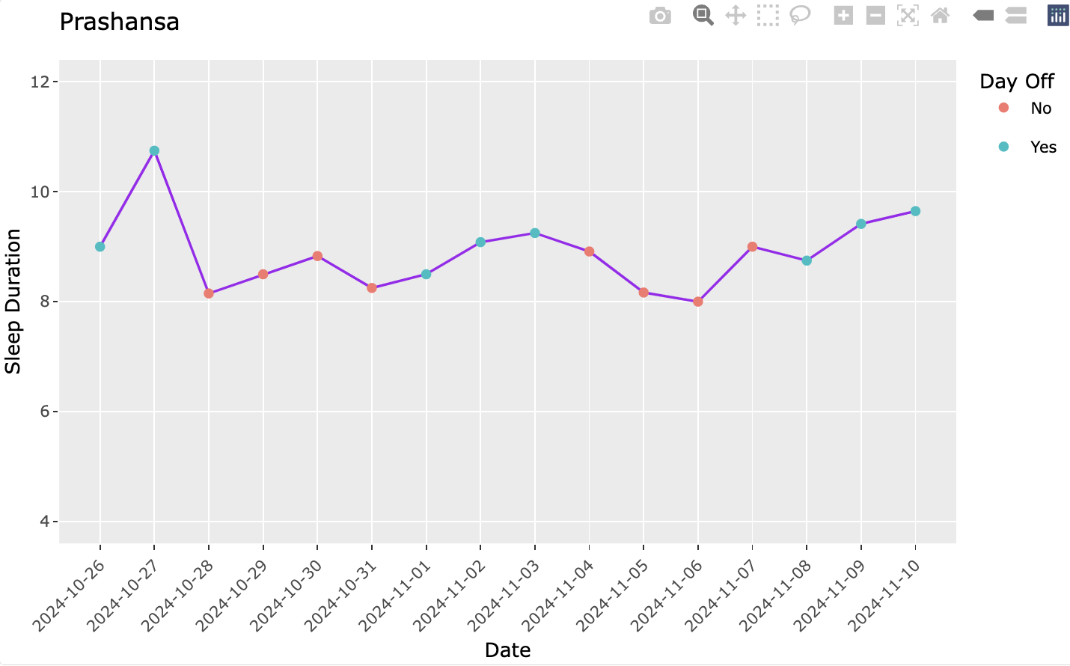

Slide 8
Hypothesis
Null Hypothesis ($H_{0}$): p = 0.5
Null Hypothesis (𝑯_𝟎): p = 0.5
Alternative Hypothesis ($H_{a}$​): p>0.5
Alternative Hypothesis (𝑯_𝒂​): p>0.5
Where, p = Proportion of people not getting enough sleep.

Slide 9
Tests
One Sample Proportion Test :
To test our claim that the proportion of people who are not getting enough sleep is over 50%.
One Sample T-Test:
To assess the participant’s sleep duration against the NSF guideline by comparing their sample mean.

Slide 10

T-test for each participants
Hypothesis Statement: The average sleep duration for each participant falls below the NSF’s recommended guideline.
Null Hypothesis ($H_{0}$): µ = NSF guideline
Alternate Hypothesis ($H_{a}$​): µ < NSF guideline
Where, µ = Average sleep duration

Slide 11
NSF Recommendation: 7 hrs
NSF Recommendation: 7 hrs
NSF Recommendation: 8 hrs
NSF Recommendation: 9 hrs

Slide 12
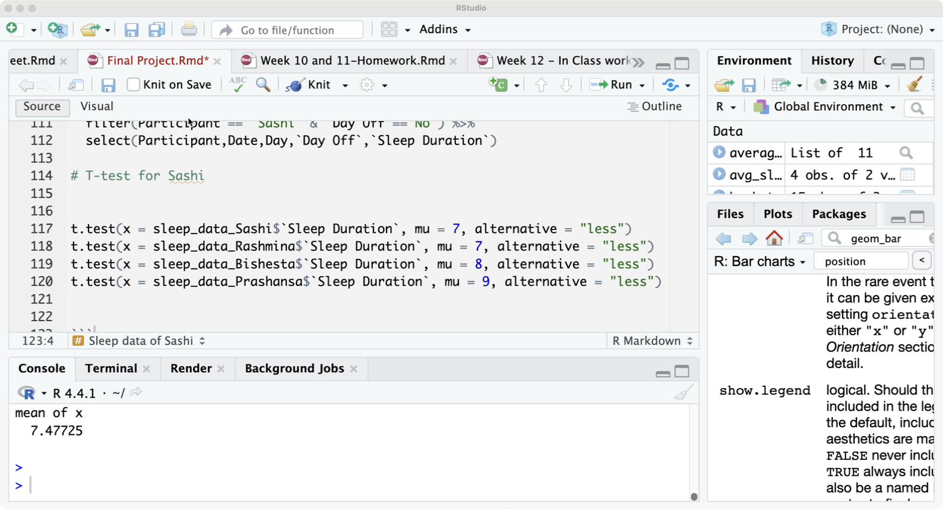
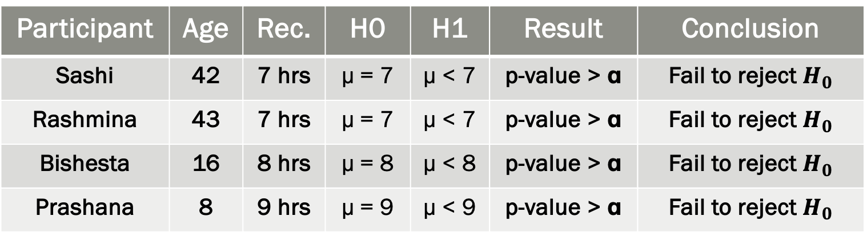
One sample T-test (ɑ=0.05)
Participant | Age | Rec. | H0 | H1 | Result | Conclusion
Sashi | 42 | 7 hrs | µ = 7 | µ < 7 | p-value > ɑ | Fail to reject $H_{0}$
Rashmina | 43 | 7 hrs | µ = 7 | µ < 7 | p-value > ɑ | Fail to reject $H_{0}$
Bishesta | 16 | 8 hrs | µ = 8 | µ < 8 | p-value > ɑ | Fail to reject $H_{0}$
Prashana | 8 | 9 hrs | µ = 9 | µ < 9 | p-value > ɑ | Fail to reject $H_{0}$
Table: Outcome of T-Tests

Slide 13
Finding from T-test
Participant | Age | Recommended Sleep Hours | Meet Recommendation?
Sashi | 42 | 7 | YES
Rashmina | 43 | 7 | YES
Bishesta | 16 | 8 | YES
Prashansa | 8 | 9 | YES
Table: Conclusion drawn from T-Tests results

Slide 14
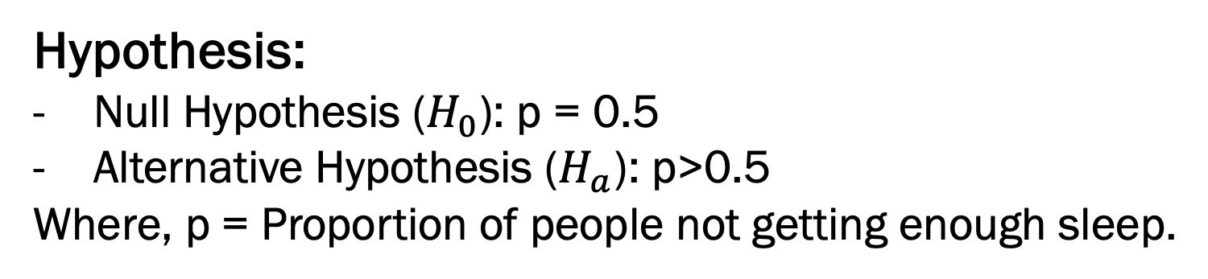
Proportion Test
Hypothesis:
Null Hypothesis ($H_{0}$): p = 0.5
Alternative Hypothesis ($H_{a}$​): p>0.5
Where, p = Proportion of people not getting enough sleep.
Sample Proportion:
Number of people not getting enough sleep (x) =0
Sample size (n) = 4

Slide 15
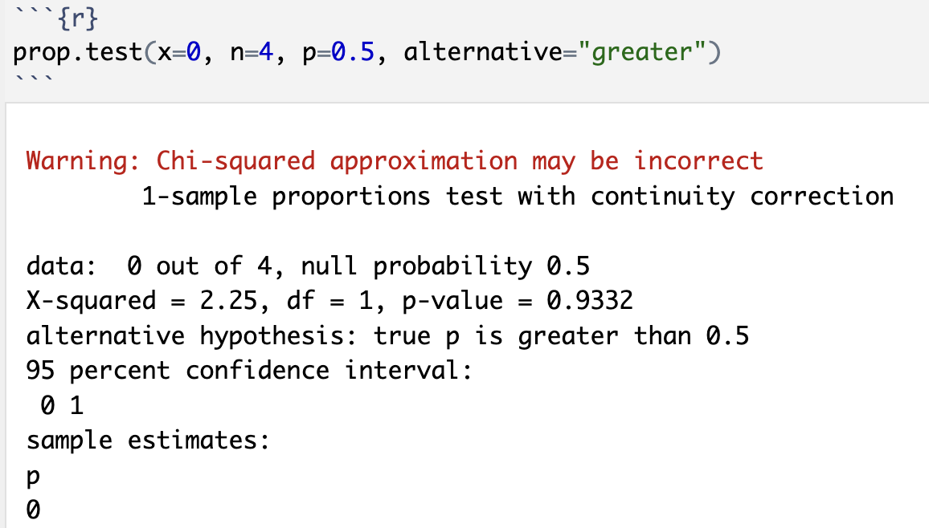
Proportion Test

Slide 16
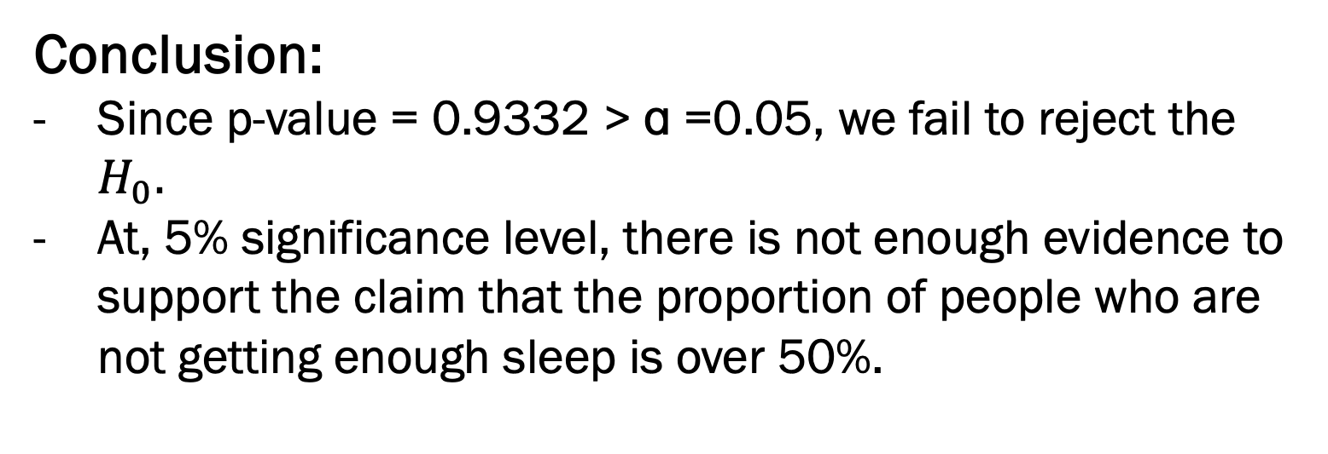
Proportion Test
Conclusion:
Since p-value = 0.9332 > ɑ =0.05, we fail to reject the $H_{0}.$
At, 5% significance level, there is not enough evidence to support the claim that the proportion of people who are not getting enough sleep is over 50%.

Slide 17

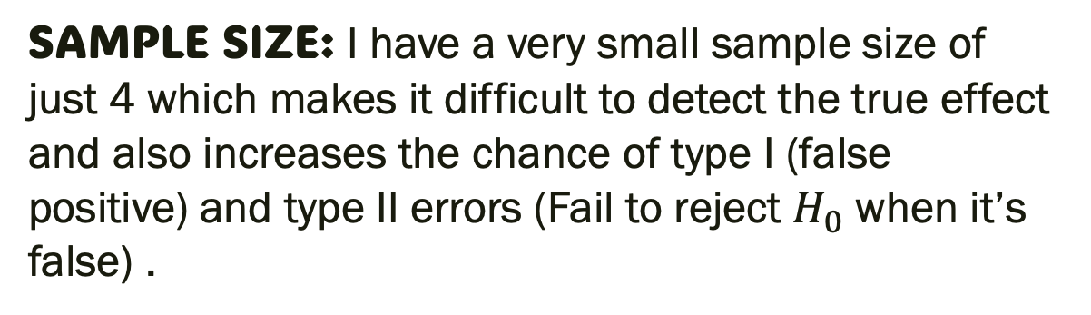
Issues & Limitations
SAMPLE SIZE: I have a very small sample size of just 4 which makes it difficult to detect the true effect and also increases the chance of type I (false positive) and type II errors (Fail to reject $H_{0}$ when it’s false) .
Violation of Normal Approximation Assumption: Since n-x < 5, the normal approximation is invalid, which could result in misleading or inaccurate outcomes.
Fails to account for confounding factors: It does not take into account confounding variables, such as "Day Off" and "Age”, that might impact the outcome.

Slide 18
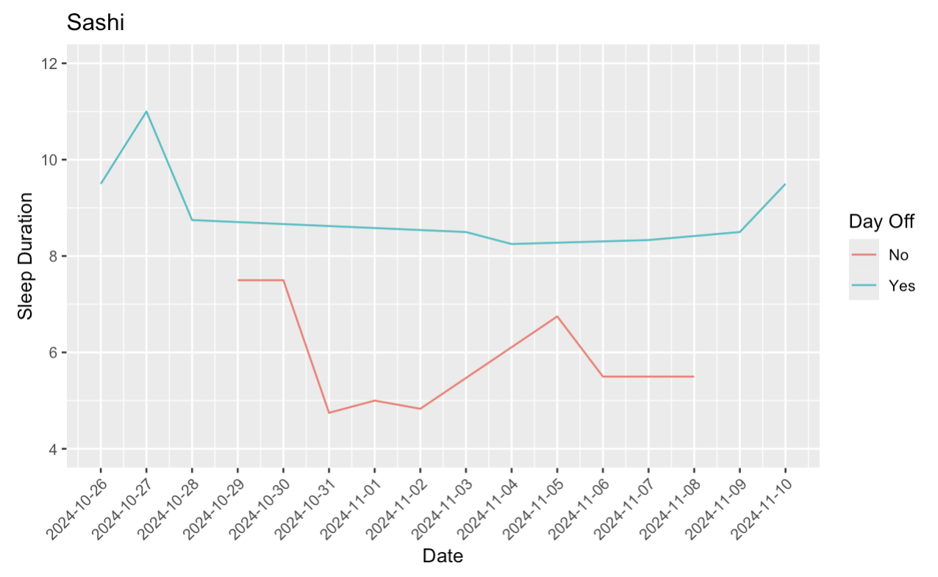
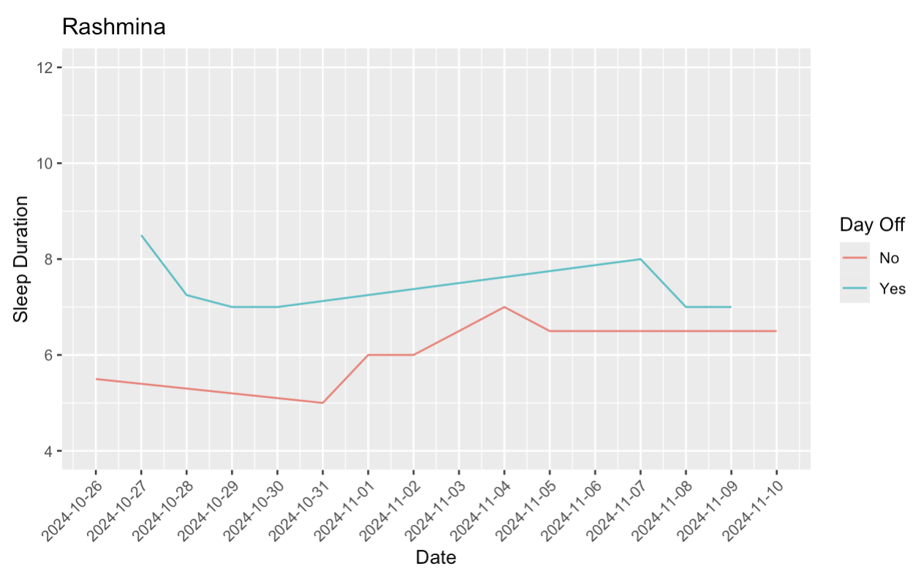
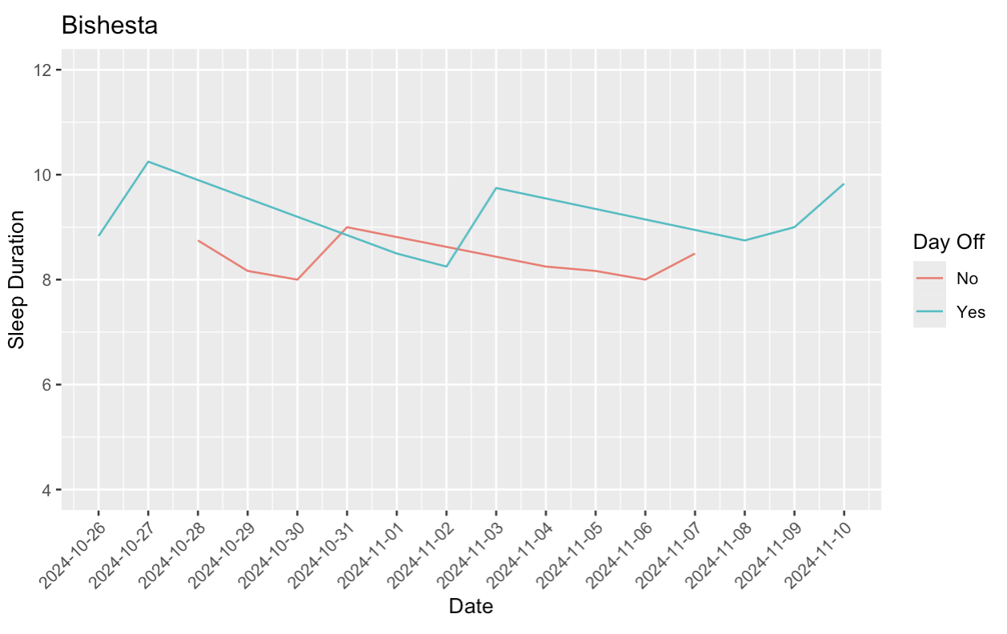
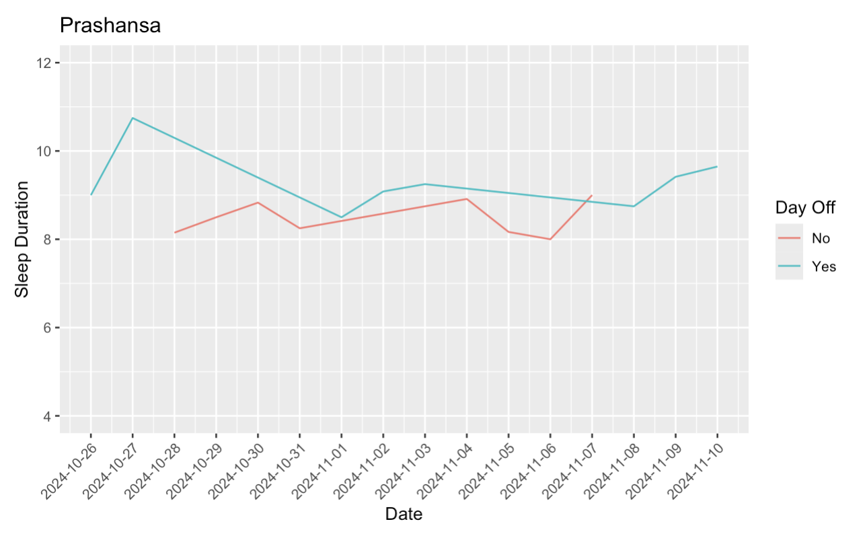

Slide 19
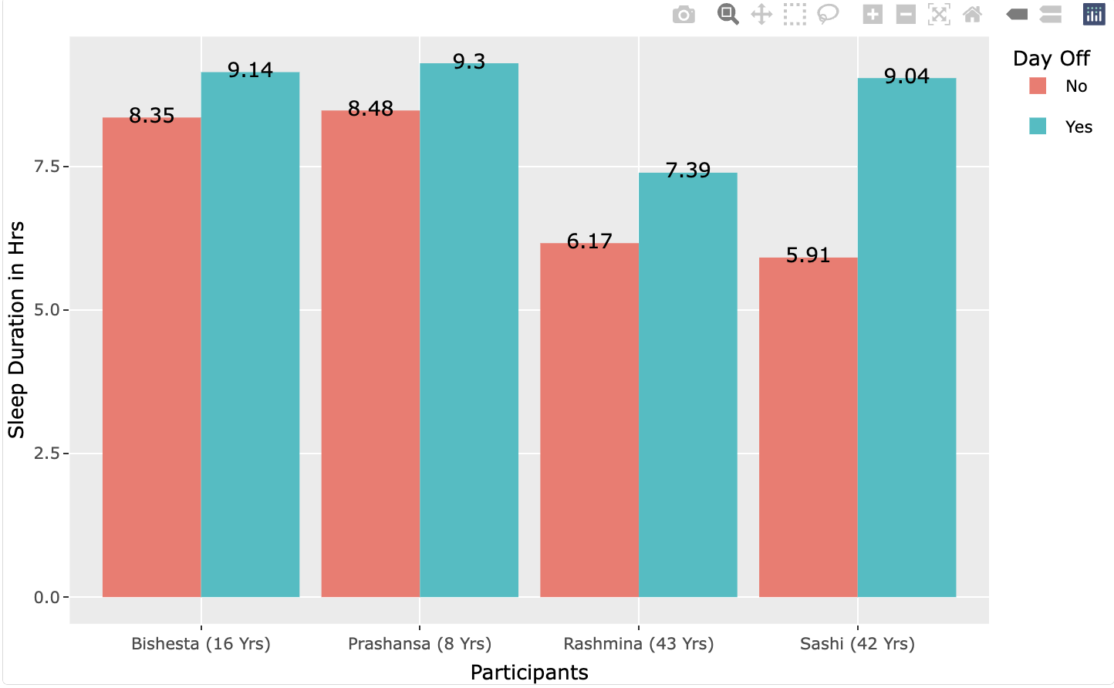

Slide 20

CONCLUSION
The use of technology such as R programming language can facilitate the handling of large dataset, automate complex analysis, and improve the visualization of data, but it’s still important to approach statistical analysis with a critical mind and an understanding of its limitation. Several factors such as data quality, sample size, focus on statistical significance over practical significance, lack of context etc. can significantly impact the reliability and interpretability of statistical analysis.

Slide 21

THANK YOU

Slide 22

Github Link
https://github.com/sashiamatya/Data-Science-and-Visualization.git

